Slide 1
LUNARSYNC
CASA0021: Group Prototype and Pitch – Group 6
Vineeth Kirandumkara
Yue Zhu (Luna)
Donghao Zhang
Ethan Low

Slide 2

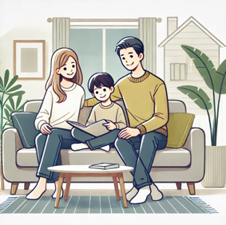
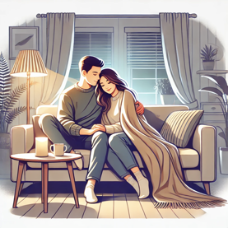
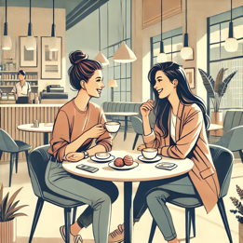
Short Pitch Statement
Lunar Sync features two ambient spheres, each with an IR temperature sensor and LED lighting. When person A touches one sphere, it glows like the moon, and the companion sphere mimics this effect, creating a unified ambiance.
When person B touches the second sphere, both begin to glow like the sun; emitting a warmer, brighter light. This synchronized change also adjusts to the users' body temperatures, to symbolize both their connection and to enrich the atmosphere, making every interaction with Lunar Sync a uniquely shared experience.
USERS

Slide 3
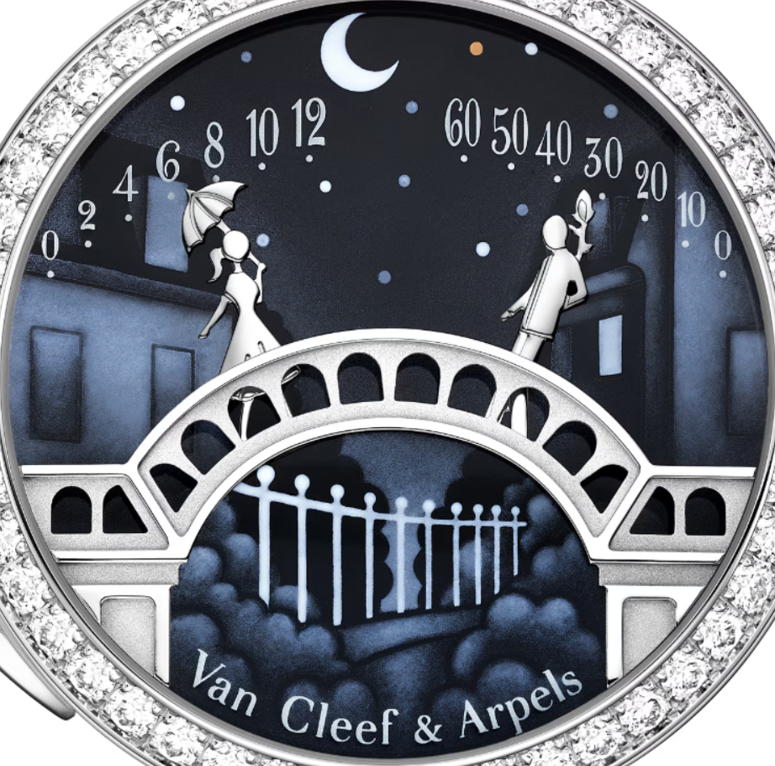
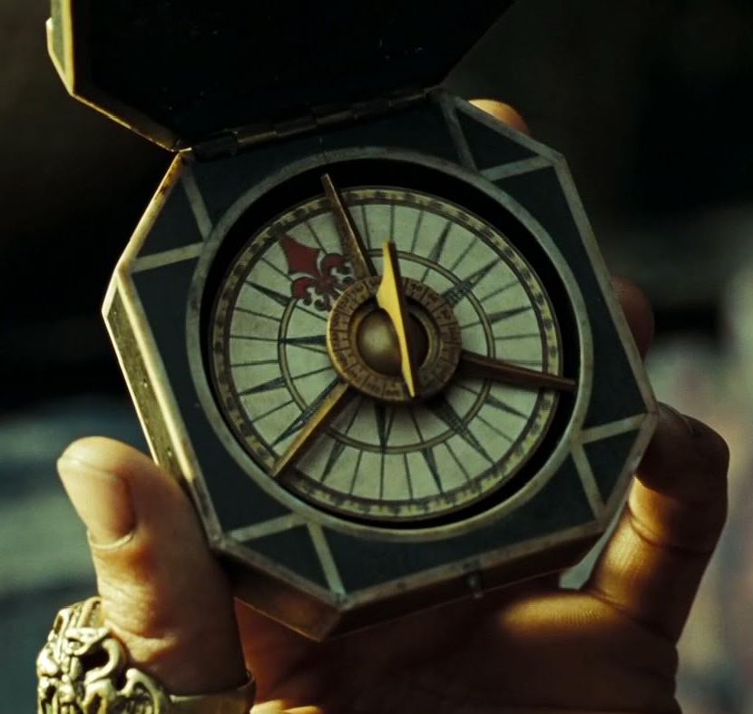
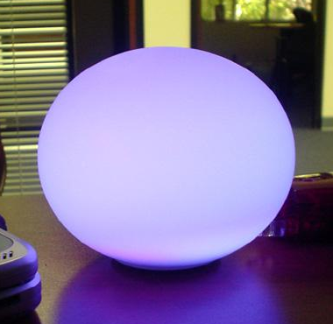
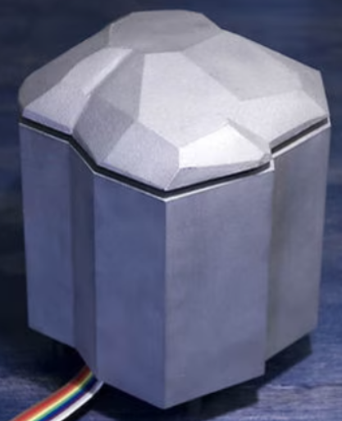
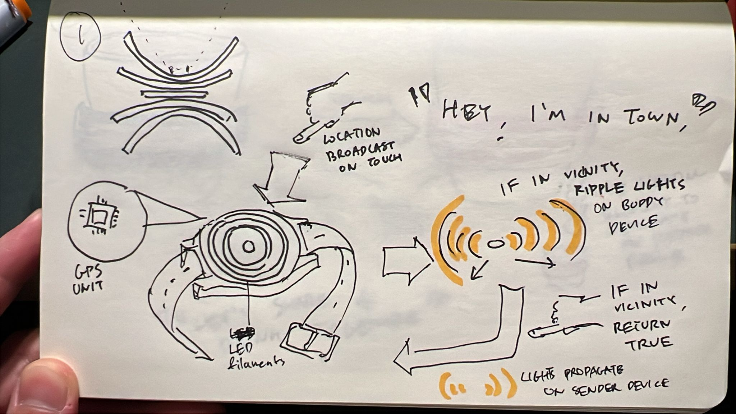
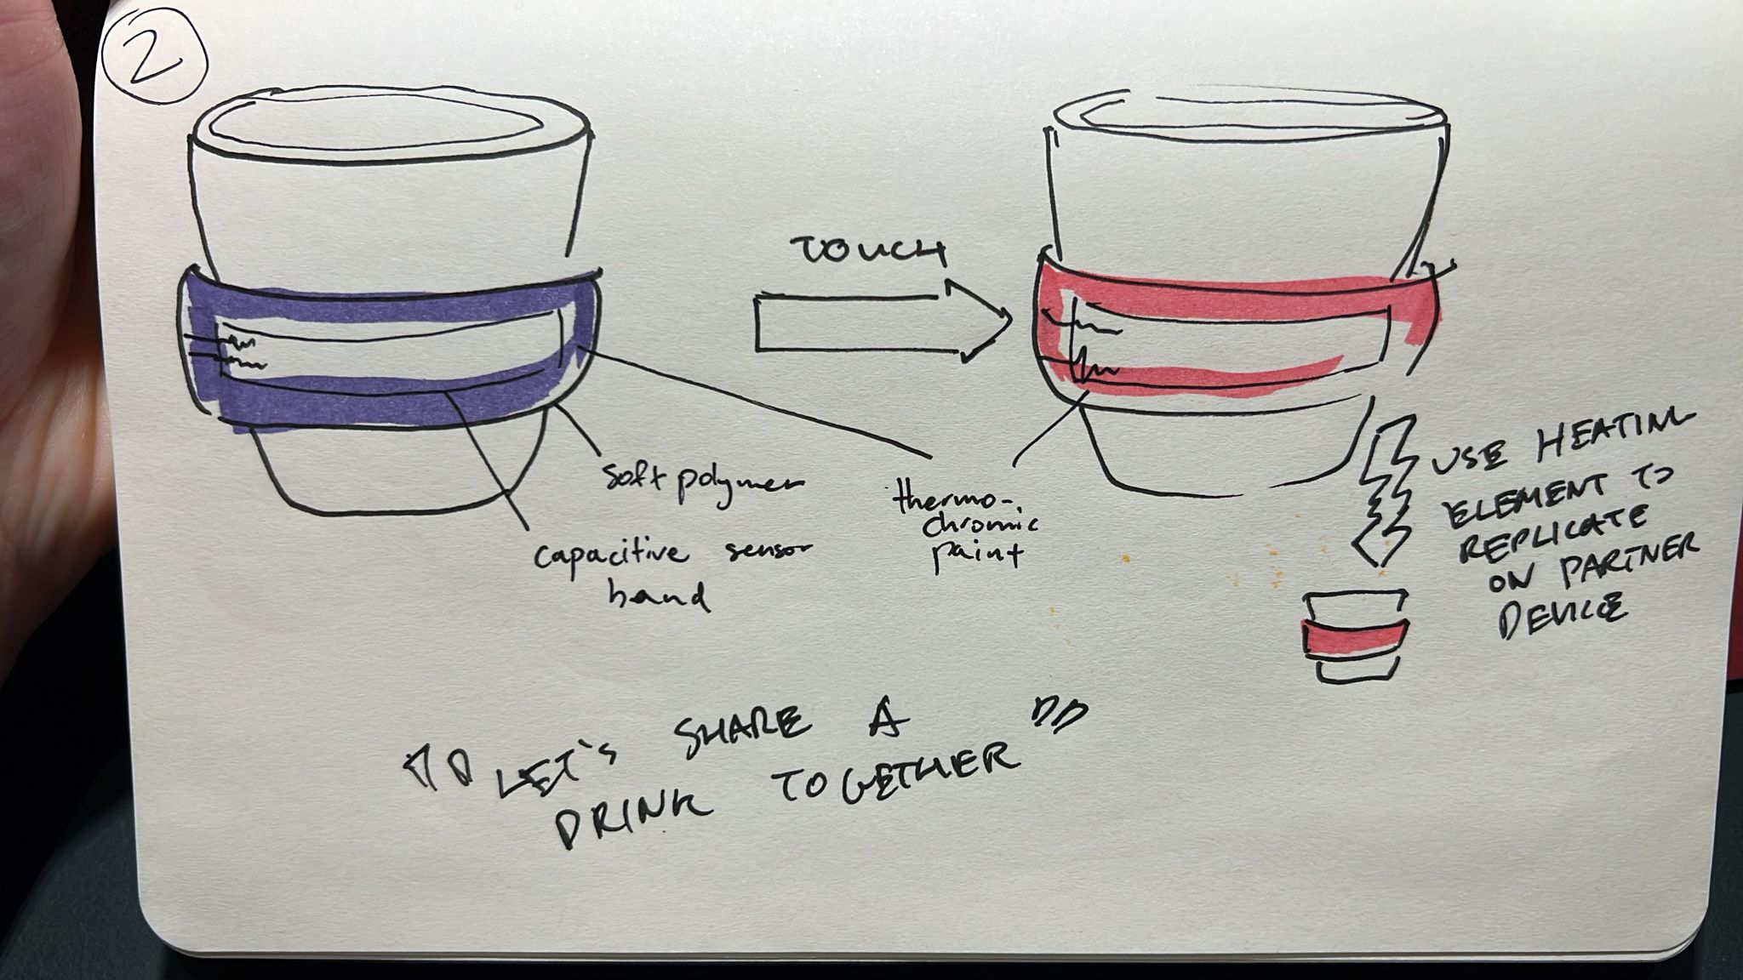
INSPIRATION
Lady Arpels Pont des Amoureux by Van Cleef & Arpels
Jack Sparrow's Compass
Ambient Sphere by Daragh Byrne at Carnagie Mellon
Cryoscope by Robb Godshaw
LOCATION
WARMTH &
FEELINGS
Across time and space...

Slide 4
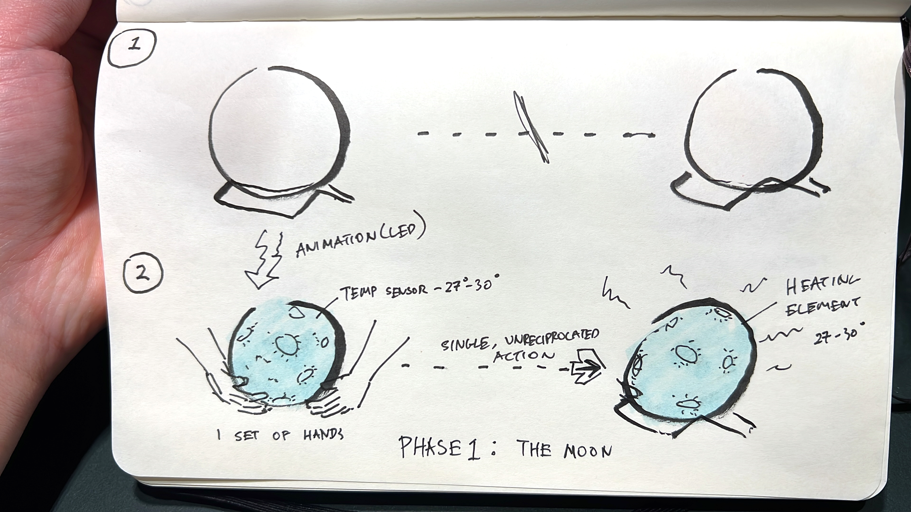
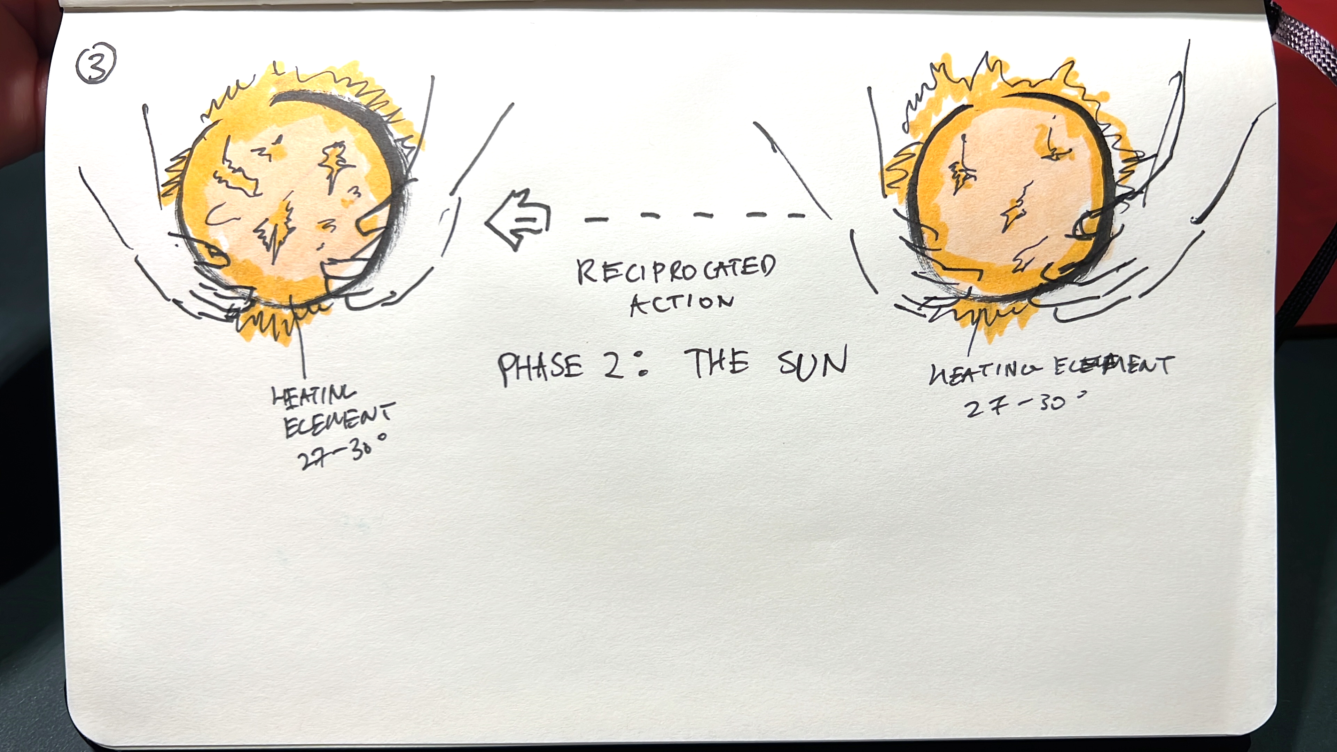
CONCEPT

Slide 5
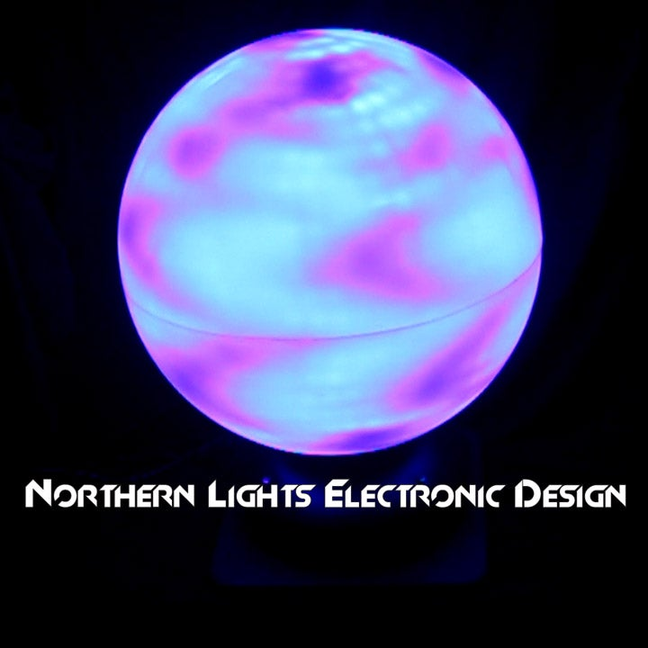
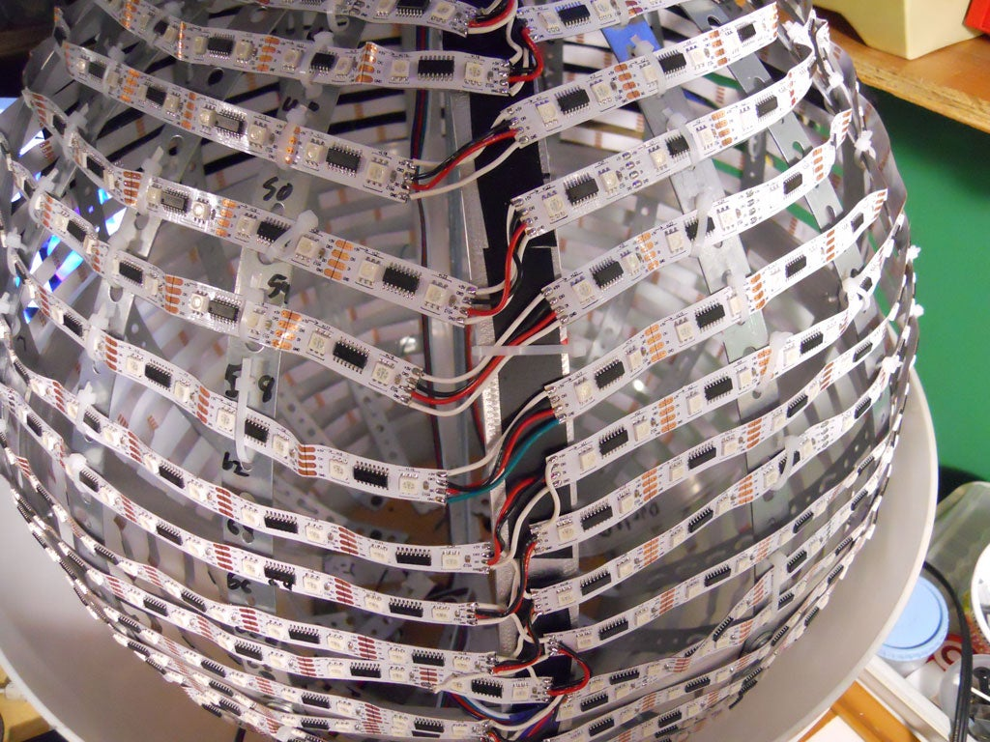
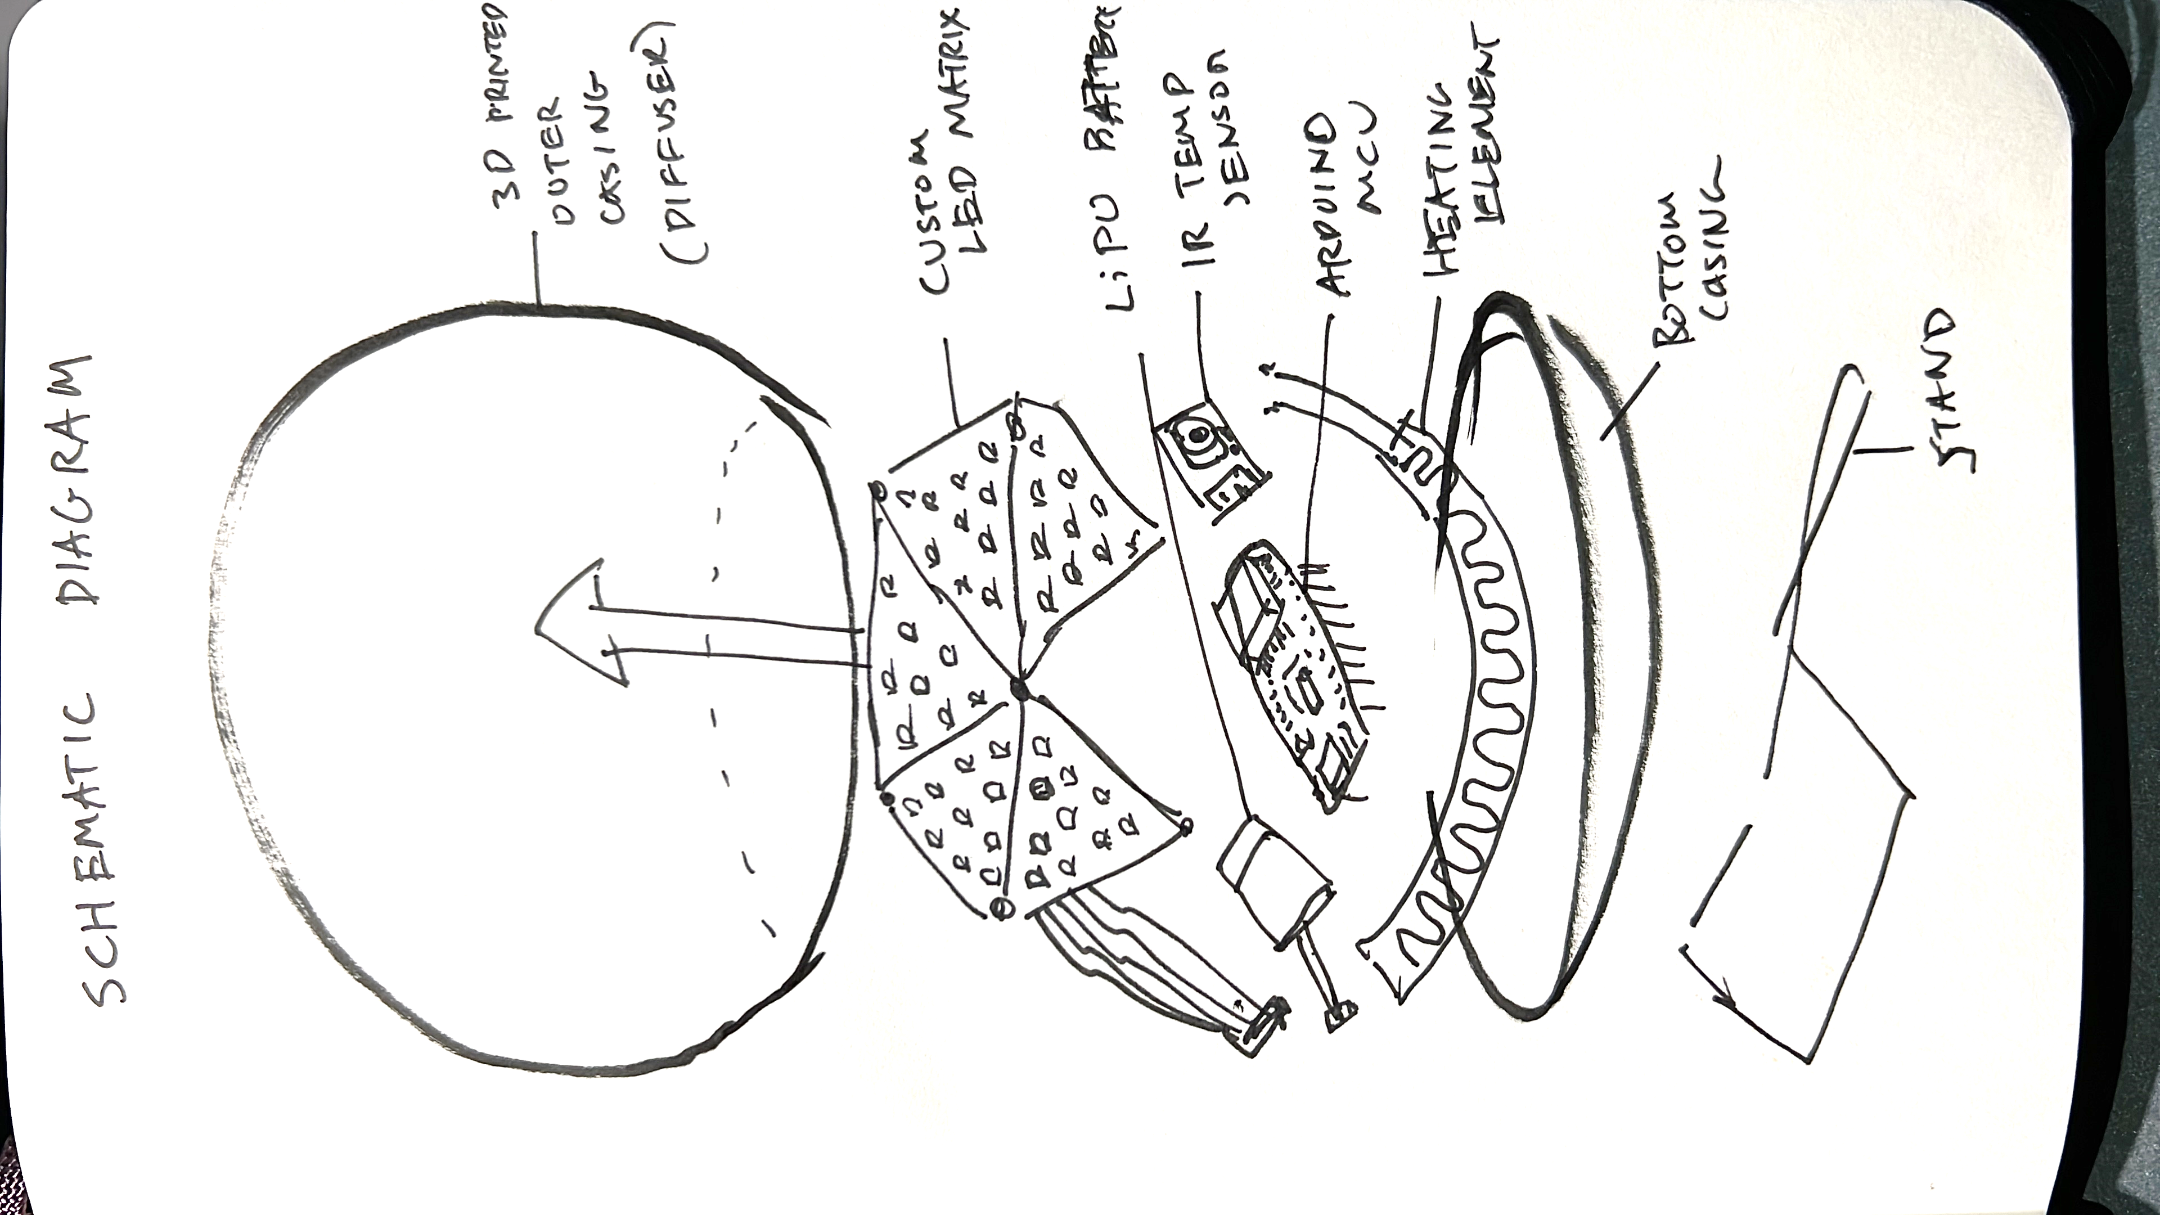
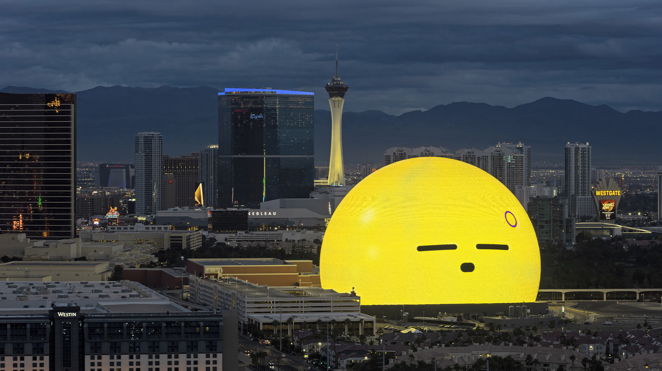
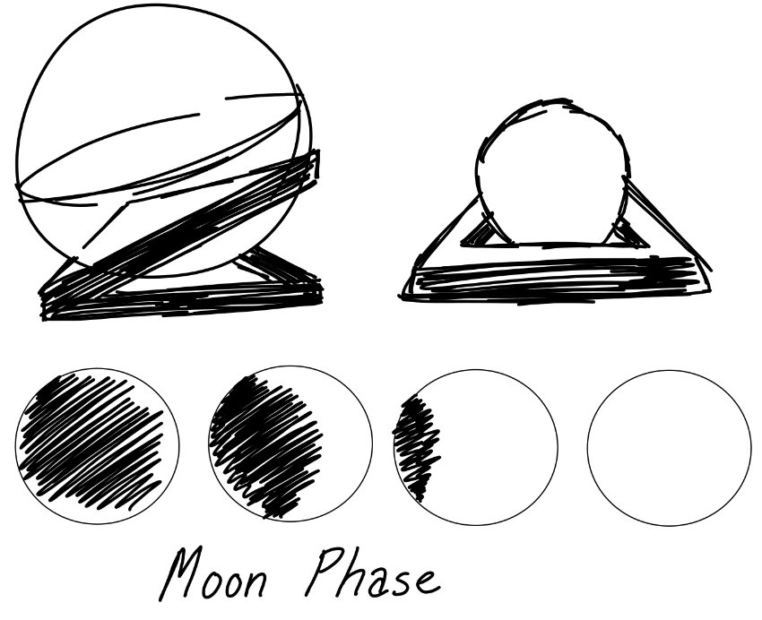
FORM
Spherical LED Matrix by NLED-Projects on Instructables
Las Vegas Sphere

Slide 6
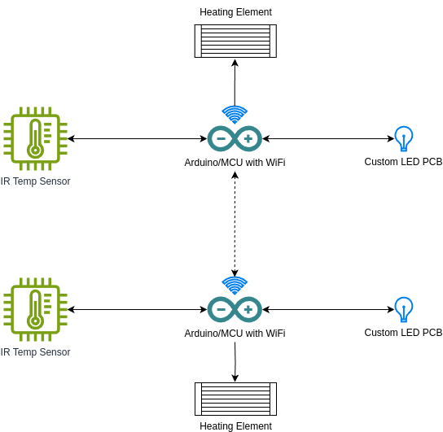
System Architecture
ARCHITECTURE

